Slide 1
Recommender System
Project of Advanced A.I. 2022/23
Done by:
Alessandro Viviani, Francesca Arredondo, Fabio Turchetta

Slide 2
Introduction
Definition:
Recommender systems are algorithms designed to predict user preferences and make personalized recommendations. These algorithms can be based on various criteria, including past purchases, search history, demographic information, and other factors.
Our Task:
Recommender system for movies, based on a record of movies already seen.

Slide 3
Introduction
Implementation used:
Collaborative Filtering method, with a model-based approach with deep learning algorithms.
Metrics used:
Hit Ratio (HR)
Normalized Discounted Cumulative Gain (NDCG)

Slide 4
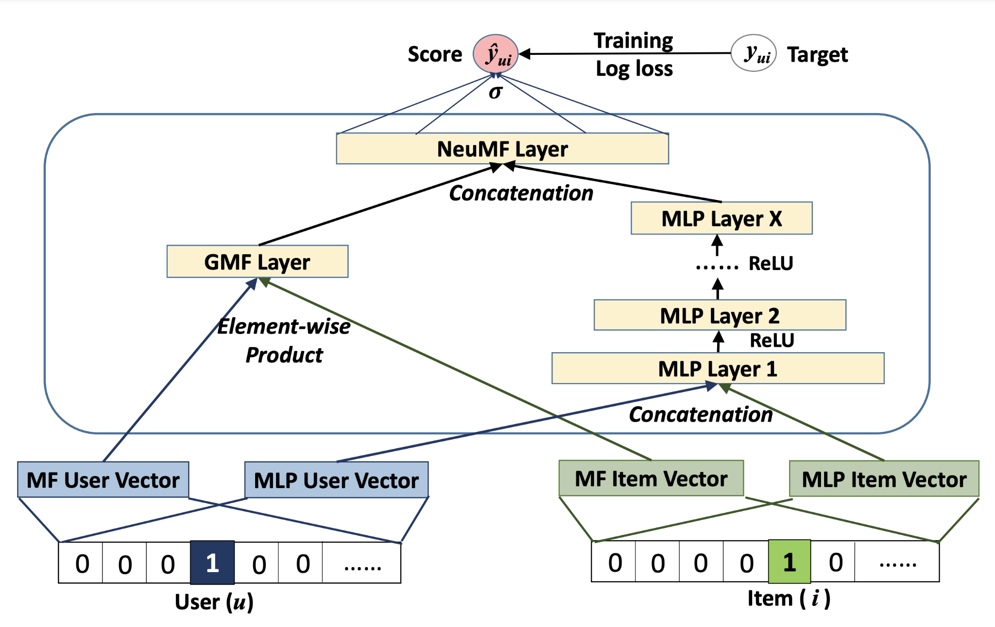
Assignment 1: NeuMF Model
Generalized Matrix Factorization:
Estimates the interaction through the inner product of the latent vectors of user and item.
Neural Collaborative Filtering:
Combine the features of the two latent vectors by concatenating them. Use a Multi-Layer Perceptron (MLP) to learn the interaction.
Neural Matrix Factorization

Slide 5
Assignment 2: Transfer Learning
Transfer learning is a machine learning method where a model developed for a task is reused as the starting point for a model on a second task.

Slide 6
NeuMF_transfer_nof
NeuMF_transfer_f
The pre-trained parameters from the MLP and GMF models are transferred to the respective layers of the NeuMF_transfer_nof and NeuMF_transfer_f models, enabling them to benefit from the knowledge learned in the pre-training phase.
output layer
output layer
fine-tune
layer_n
layer_n
fine-tune
freezed
layer_0
layer_0
target dataset

Slide 7
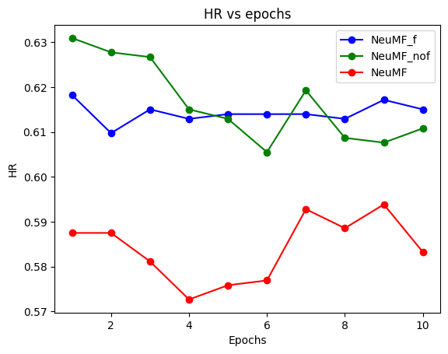
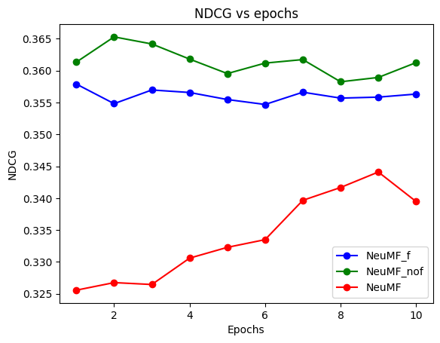
Comparison: NeuMF_f, NeuMF_nof, NeuMF

Slide 8
Assignment 3: Explainable AI
Explainable AI refers to methods and techniques in the application of artificial intelligence such that the results can be understood by humans.

Slide 9
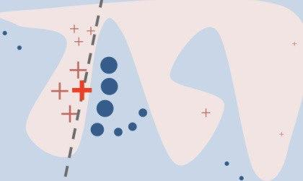
LIME
LIME (Local Interpretable Model Agnostic Explainer)
Generation of perturbed instances
Sampling of data
Creation of an interpretable model
Identification of relevant features

Slide 10
LIME
in a recommender system
First approach:
Select a User
Select N Items (1 with positive interaction and N-1 with negative interaction
Second approach:
Select 1 Item
Select N Users who interact with it
Select M Users who don’t interact with it

Slide 11
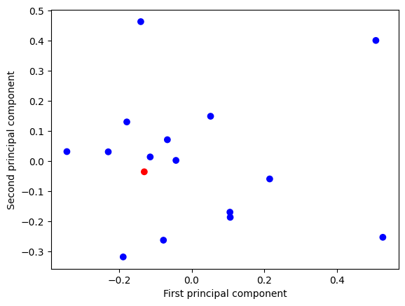
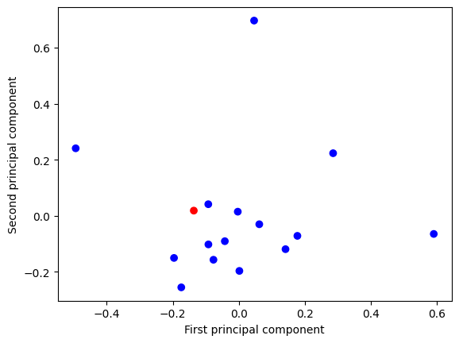
LIME
in a recommender system
Third approach:
Select a User
Find a cluster of Users around him
Compare features with a User “far” from the cluster

Slide 12
Assignment 4: Attention Mechanism
Definition:
In machine learning, the attention mechanism refers to the model's ability to focus on few relevant parts of the input when generating the output.
It enables the model to assign weights to the elements of the input sequence and better understand their context and dependencies.

Slide 13
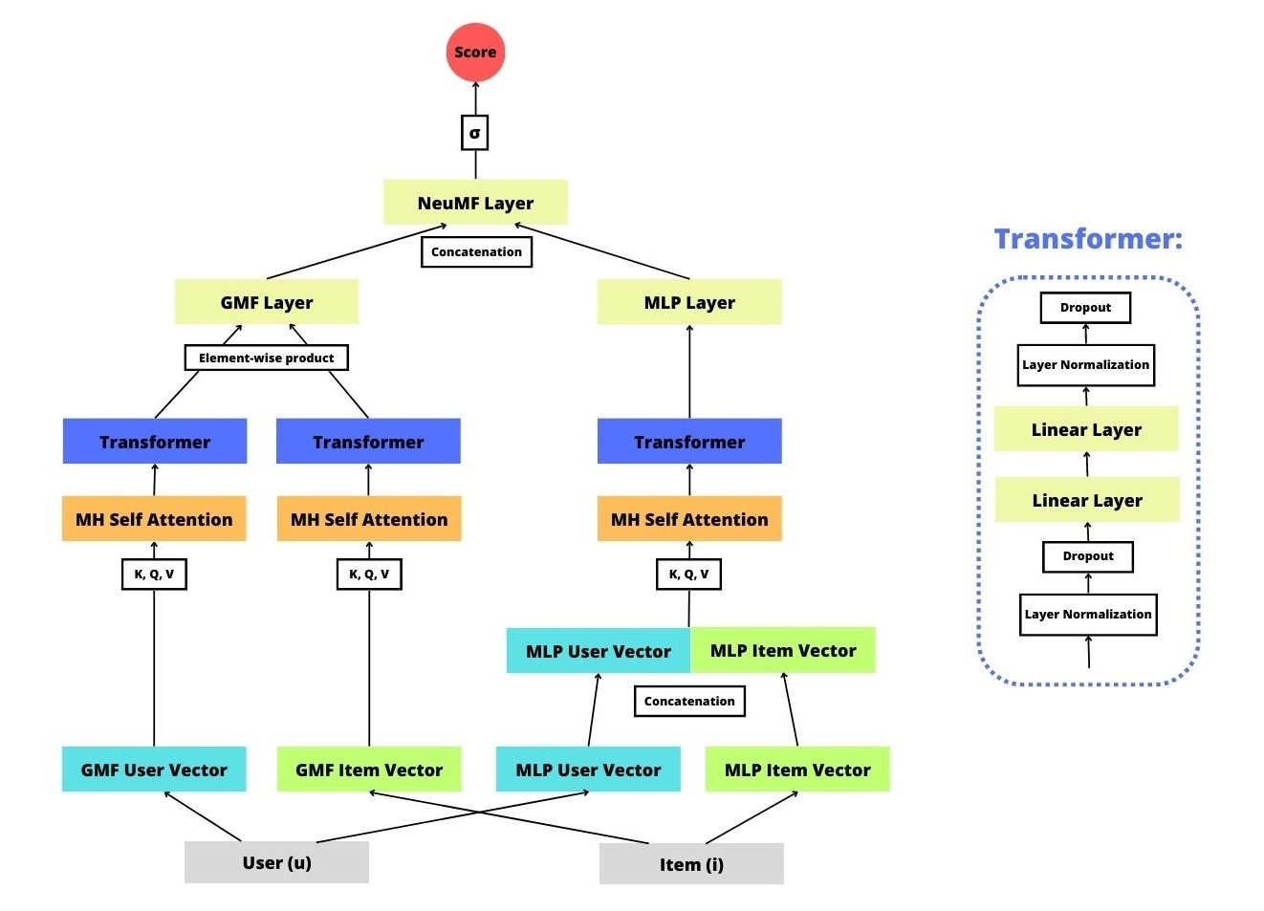
Assignment 4: Viviani’s Model
The architecture follows the paper: "Deep Collaborative Recommendation Algorithm Based on Attention Mechanism" by Can Cui published in 2022.

Slide 14
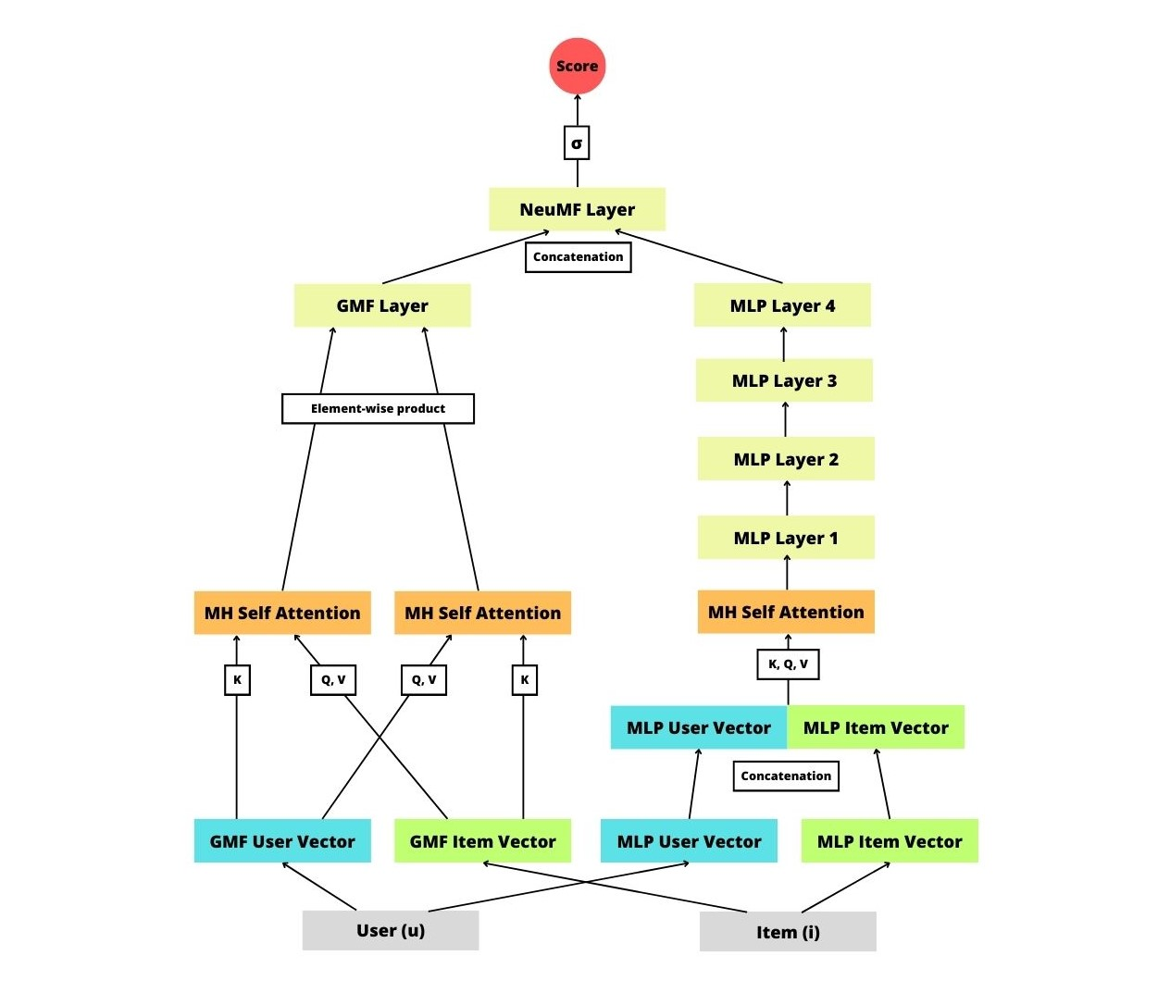
Assignment 4:
Turchetta’s Model

Slide 15
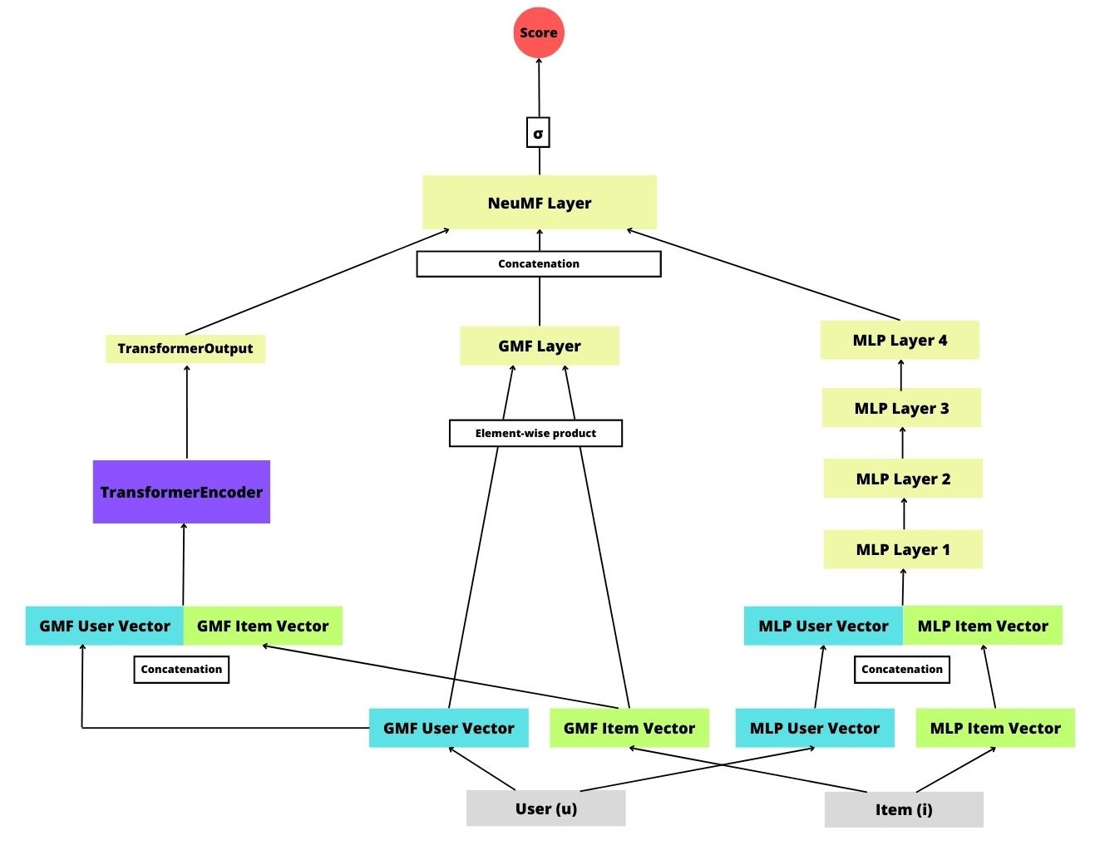
Assignment 4:
Arredondo’s Model

Slide 16
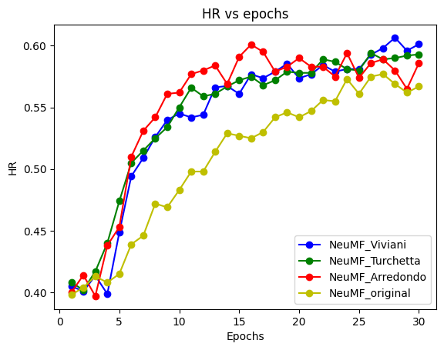
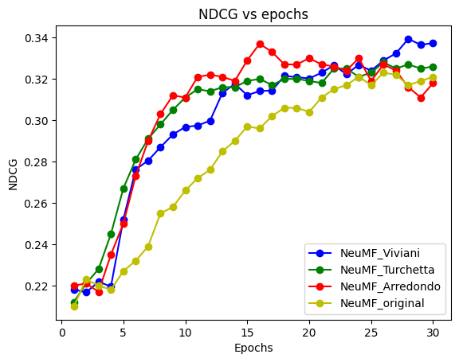
Comparison: with and without attention

Slide 17
Thanks For The Attention

